Slide 1
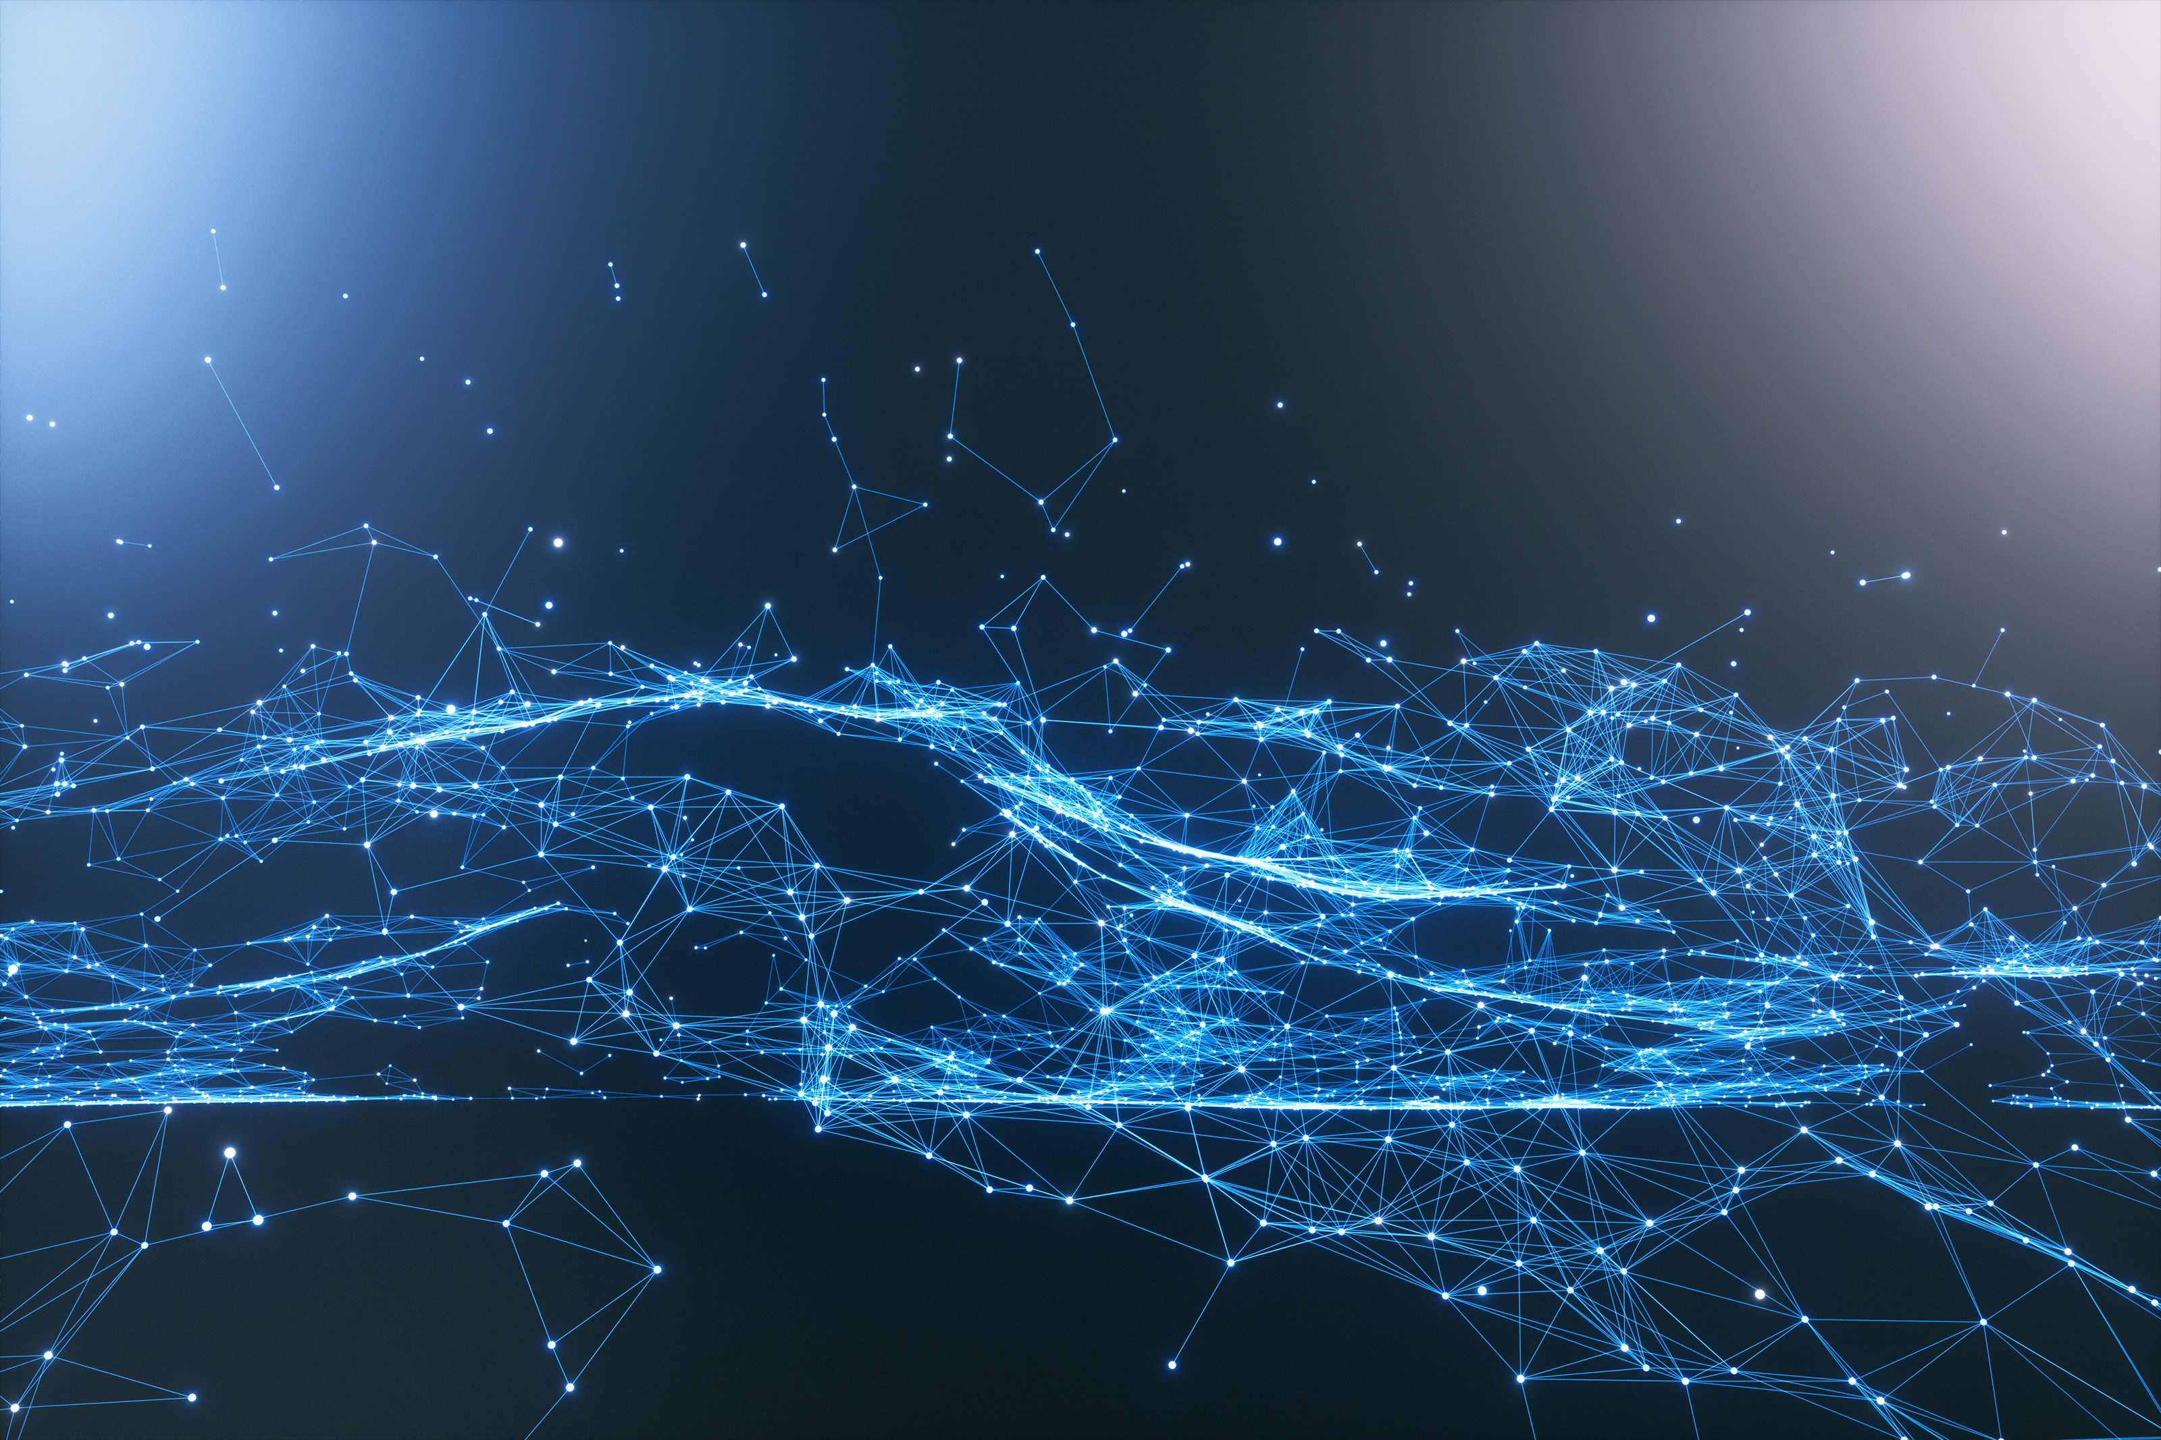
Attention is All You Need
소프트웨어학과 4학년 윤혜진

Slide 2
Dominant sequent transduction models
Base on CNN/RNN
Best performing – through attention mechanism
Recursion → hard to parallelize

Slide 3
Transformer
Only Attention mechanism !
Dispensing with recurrence and convolutions
→ parallelizable, more efficient

Slide 4
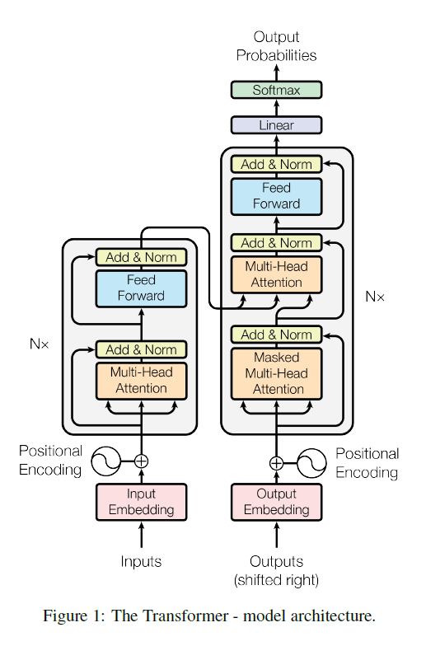
Transformer

Slide 5
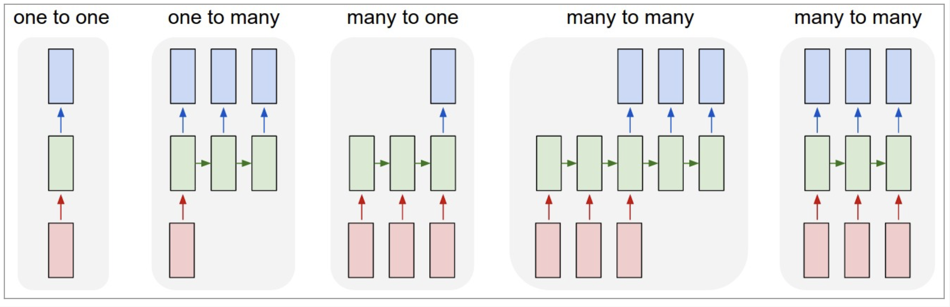
RNN (Recurrent Neural Network)
Sequence Model
Sequence ? Ex) 단어, 문장
Difference from other neural network : hidden state
Notes:
https://dreamgonfly.github.io/blog/understanding-rnn/ 이미지 출처

Slide 6
Seq2Seq (Sequence to Sequence)
Base on RNN
Problem 1. Context Size
Problem 2. Vanishing Gradient problem of RNN
→ Attention
Sequence
Encoder
Context
Decoder
Sequence
Notes:
출처 https://wikidocs.net/24996

Slide 7
Attention Mechanism
To correct poor accuracy when long input sequence
Recheck the entire input every time step to predict output
Attention: associated input

